Slide 1
UNIT 4 VT IN CLOUD COMPUTING
Prepared by
Er.Harendra Bikram Shah
(Lecturer)
Department of Computer Science

Slide 2
OUTLINES
Introduction to Virtualization Technology
Hypervisor and its Types
Virtual Machines
VM management and configurations
Cloud Data stores
Cloud Computing and Virtualization

Slide 3
Introduction to VT
It is the "creation of a virtual (rather than actual) version of something, such as a server, a desktop, a storage device, an operating system or network resources".
In other words, Its a technique, which allows to share a single physical instance of a resource or an application among multiple customers and organizations.
It is also known as changing the mindset from physical to logical.
concept behind the Virtualization
Creation of a virtual machine over existing operating system and hardware
Two machines are there :Host Machine and Guest Machine

Slide 4
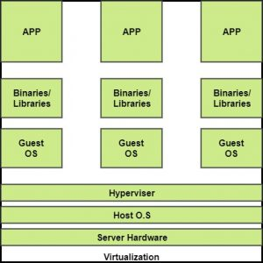

Slide 5
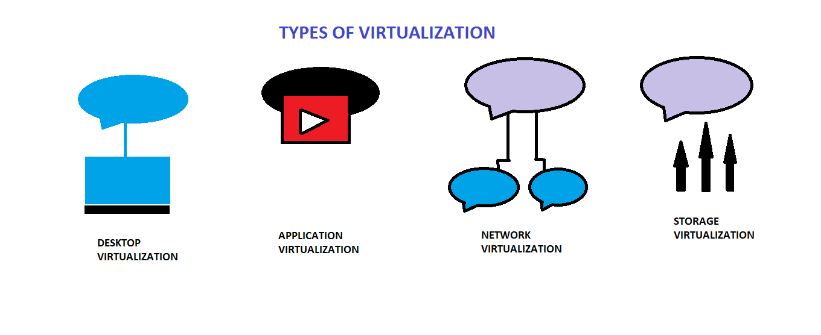
BENEFITS OF VIRTUALIZATION 1. More flexible and efficient allocation of resources. 2. Enhance development productivity. 3. It lowers the cost of IT infrastructure. 4. Remote access and rapid scalability. 5. High availability and disaster recovery. 6. Pay peruse of the IT infrastructure on demand. 7. Enables running multiple operating systems.
Types of Virtualization:
1.Application Virtualization.
2.Network Virtualization.
3.Desktop Virtualization.
4.Storage Virtualization.
5.Server Virtualization.
6.Data virtualization.

Slide 6
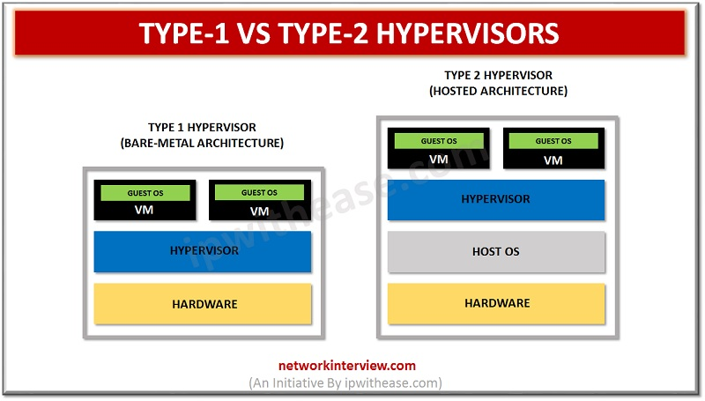
HYPERVISOR
It’s a software layer that runs between host machine(physical server) and
guest machine(virtual machine)
It is also known as VMM (Virtual Machine Monitor)
Two Types of Hypervisor:
Type 1 hypervisor: hypervisors run directly on the system hardware – A “bare metal” embedded hypervisor,
They are good for Server Installing
Type 2 hypervisor: hypervisors run on a host operating system that provides virtualization services,
such as I/O device support and memory management.

Slide 7
Type 2 hypervisor
1. VMware Workstation/Fusion/Player
It is free and allows to run only one virtual machine (VM)
It is a more robust hypervisor that can record-and-replay and provide VM snapshot support.
2. VMware Server
VMware Server is a free, hosted virtualization hypervisor that’s very similar to the VMware Workstation. 3. Microsoft Virtual PC
latest Microsoft’s version of this hypervisor technology, Windows Virtual PC and runs only on Windows 7 and supports only Windows operating systems running on it.
4. Oracle VM VirtualBox
Budget friendly virtualization .
features like VMware vSphere and Microsoft Hyper-V.
5. Red Hat Enterprise Virtualization
It has Type 1 and Type 2 features KVM. It can turn the Linux kernel itself into a hypervisor so the VMs have direct access to the physical hardware.
Type 1 hypervisors:
VMware ESX and ESXi
Free as well as Costly for commercial purpose
2. Microsoft Hyper-V
Not free used in windows server
3. Citrix XenServer
Open source ,Free of Cost used for servers 4. Oracle VM
The Oracle hypervisor is based on the open source Xen. However, if you need hypervisor support and product updates, it will cost you.

Slide 8
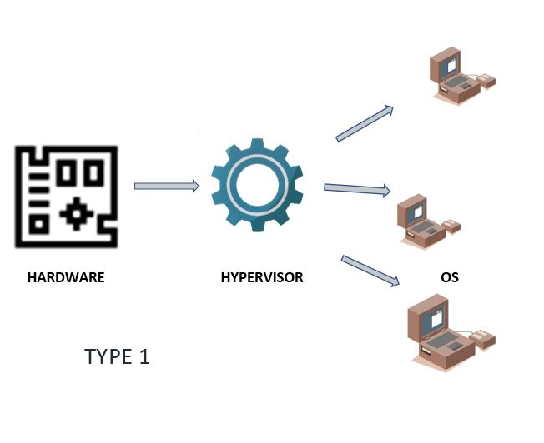
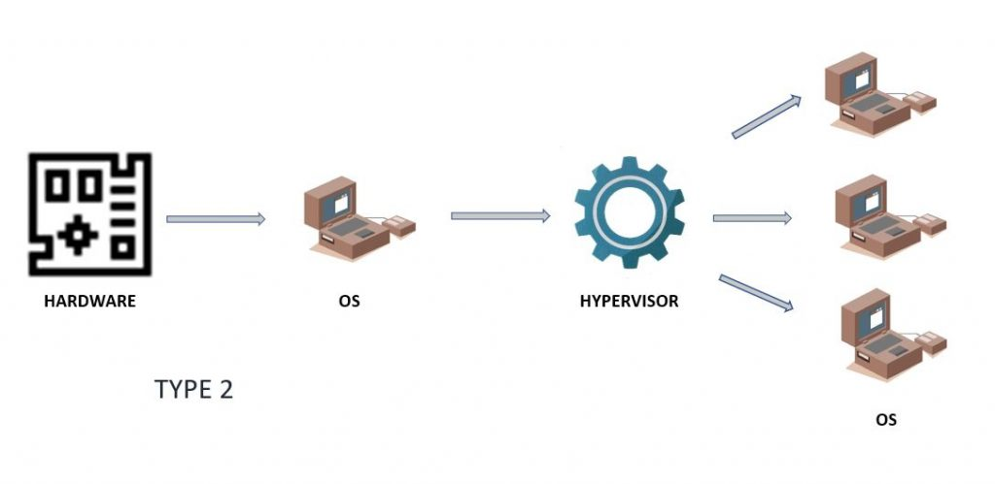

Slide 9
Benefits of hypervisors:
Speed
Efficiency:
Flexibility:
Portability:
Need of hypervisor:
Hypervisors make it possible to use more of a system’s available resources and provide greater IT mobility
Because multiple virtual machines can run off of one physical server with a hypervisor, a hypervisor reduces:
Space
Energy
Maintenance requirements

Slide 10
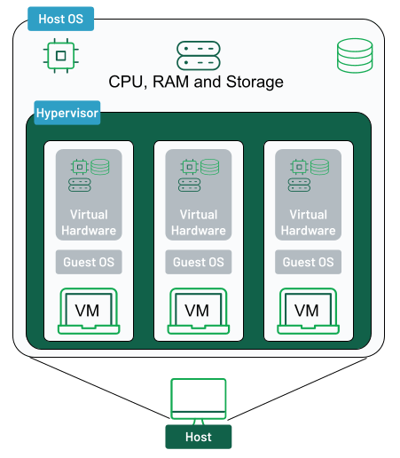
Virtual Machine
It is a computer resource that uses software instead of a physical computer to run programs and deploy apps.
Another word VM is a virtual environment that works like a computer within a computer.
Working of Virtual Machine

Slide 11
Advantages of virtual machines
Reduces cost
Act as a Single System
Disaster Recovery
Agility and speed
scalability
Disadvantages of virtual machines
Unstable performance due to lack of infrastructure
Slower and low in efficiency
Skilled and dedicated man power

Slide 12
Applications of VMs:
Building and deploying apps to the cloud.
Trying out a new operating system (OS), including beta releases.
Spinning up a new environment to make it simpler and quicker for developers to run dev-test scenarios.
Backing up your existing OS.
Accessing virus-infected data or running an old application by installing an older OS.
Running software or apps on operating systems that they weren't originally intended for.

Slide 13
VM management and configurations
the arrangement of resources assigned to a virtual machine
Include allocated processors, memory, disks, network adapters and the user interface.
Virtual machines can be created quickly and easily

Slide 14
Cloud Data stores
It’s a model that stores data on the Internet through a cloud computing provider who manages and operates data storage as a service.
It’s delivered on demand with just-in-time capacity and costs, and eliminates buying and managing your own data storage infrastructure.
This gives you agility, global scale and durability, with “anytime, anywhere” data access.
Working of Cloud Storage
Cloud storage is purchased from a third party cloud vendor who owns and operates data storage capacity and delivers
These cloud storage vendors manage capacity, security and durability to make data accessible to your applications.
Benefits of Cloud Storage
Total Cosst of Ownership.
Time to Deployment.
Information Management.

Slide 15
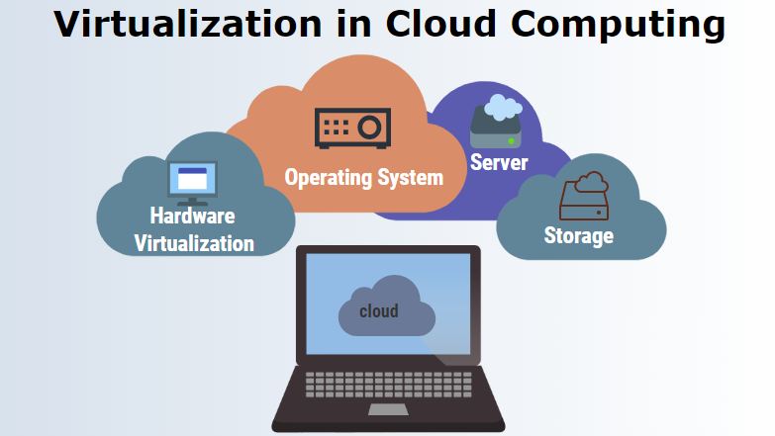
Cloud Computing and Virtualization

Slide 16
END of the UNIT 4

